Slide 1
Species Distribution Modeling
Camille Ross
Research Technician, Record Lab

Slide 2
Overview

Slide 3
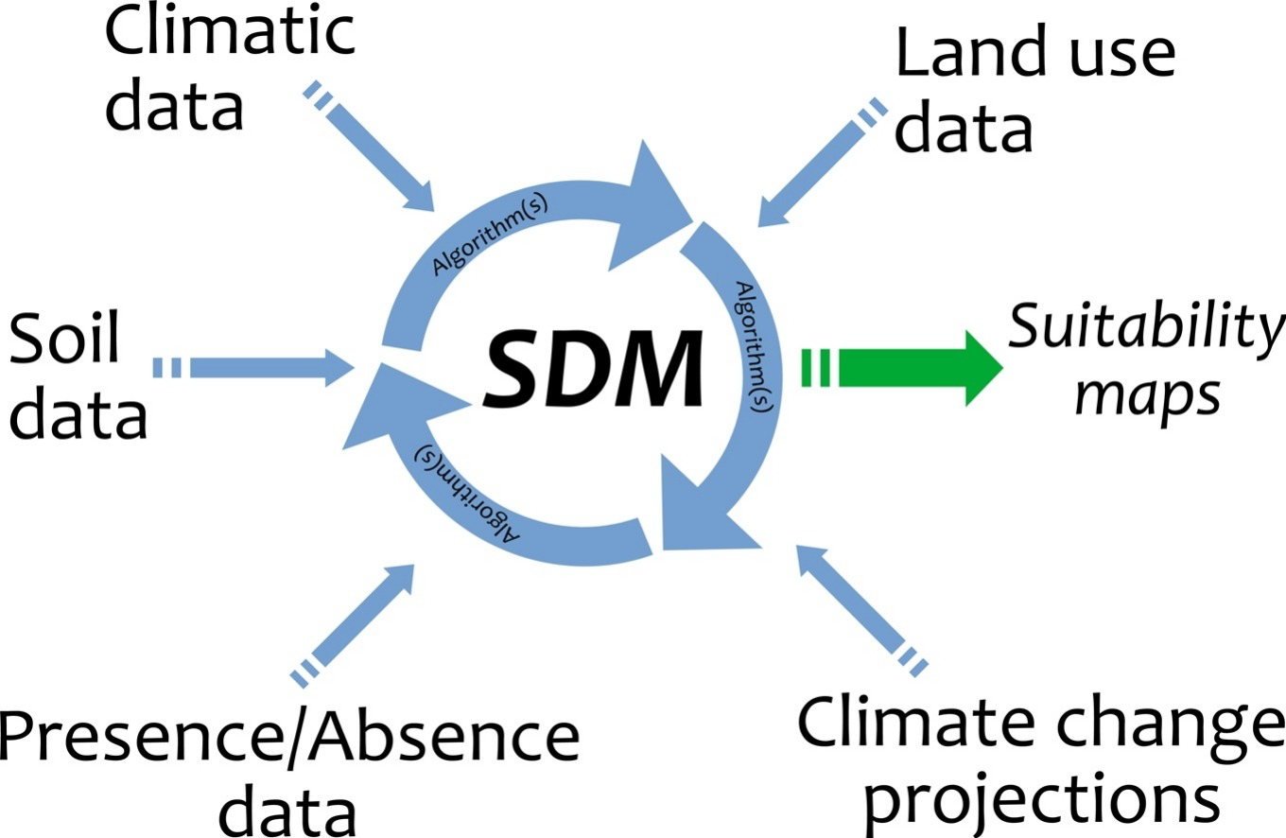
Overview
Helpful tool for ecologists
Enables us to better understand distribution of species
Can be across different spatial and temporal domains
Source: 1-s2.0-S0304380019303254-ga1.jpg

Slide 4
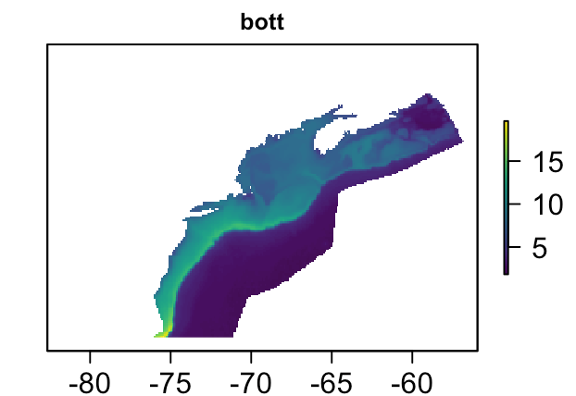
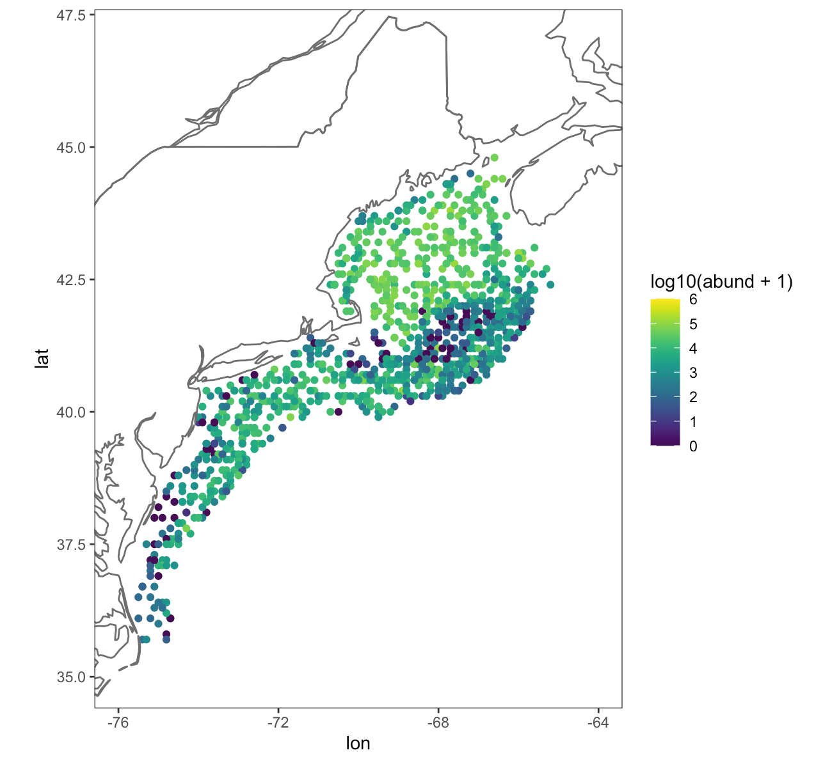
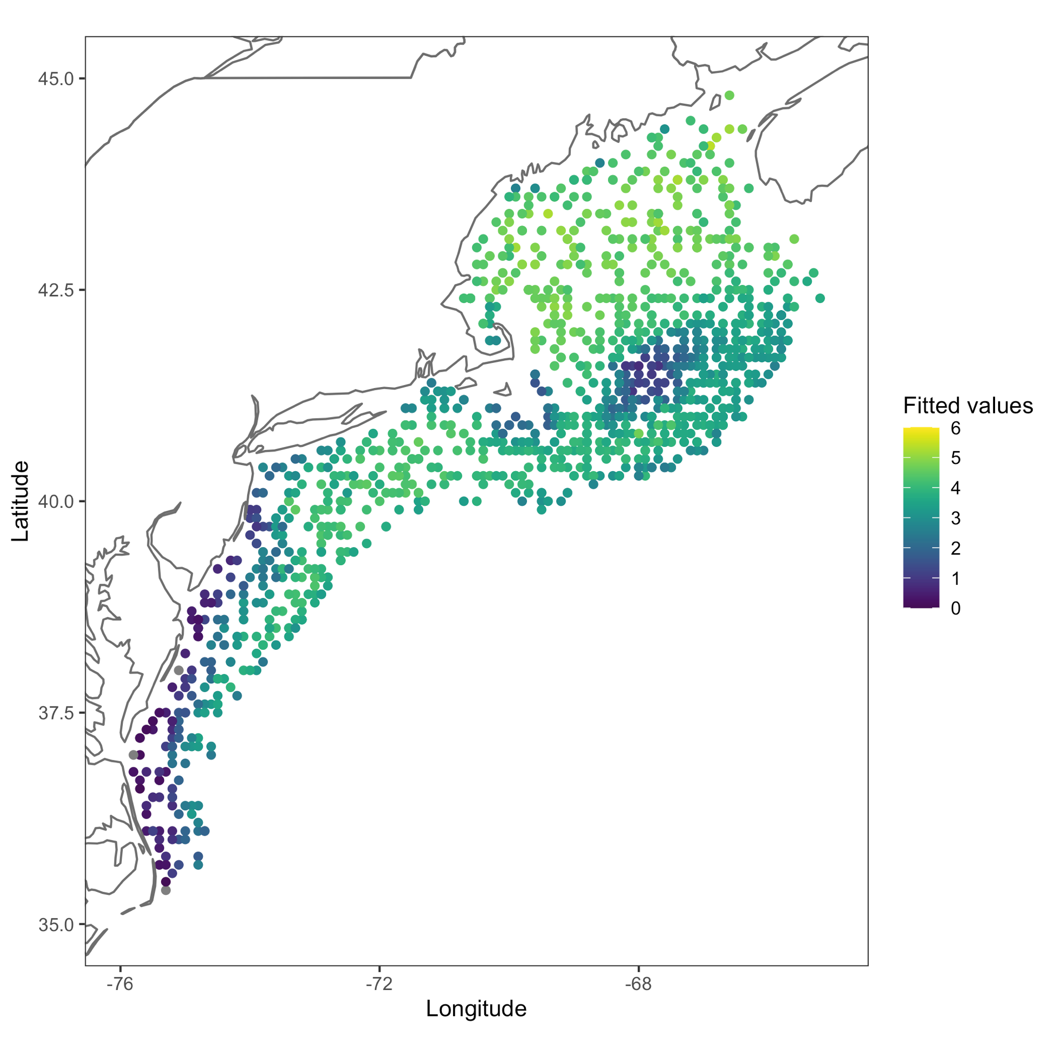
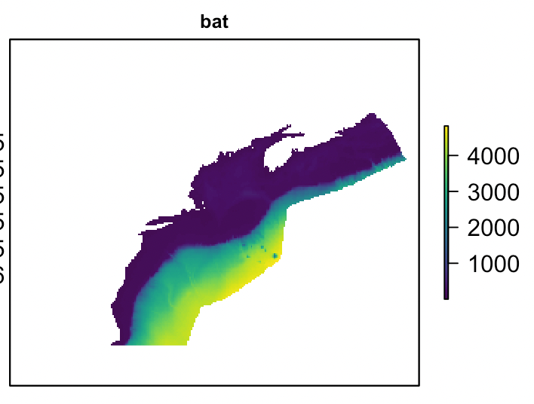
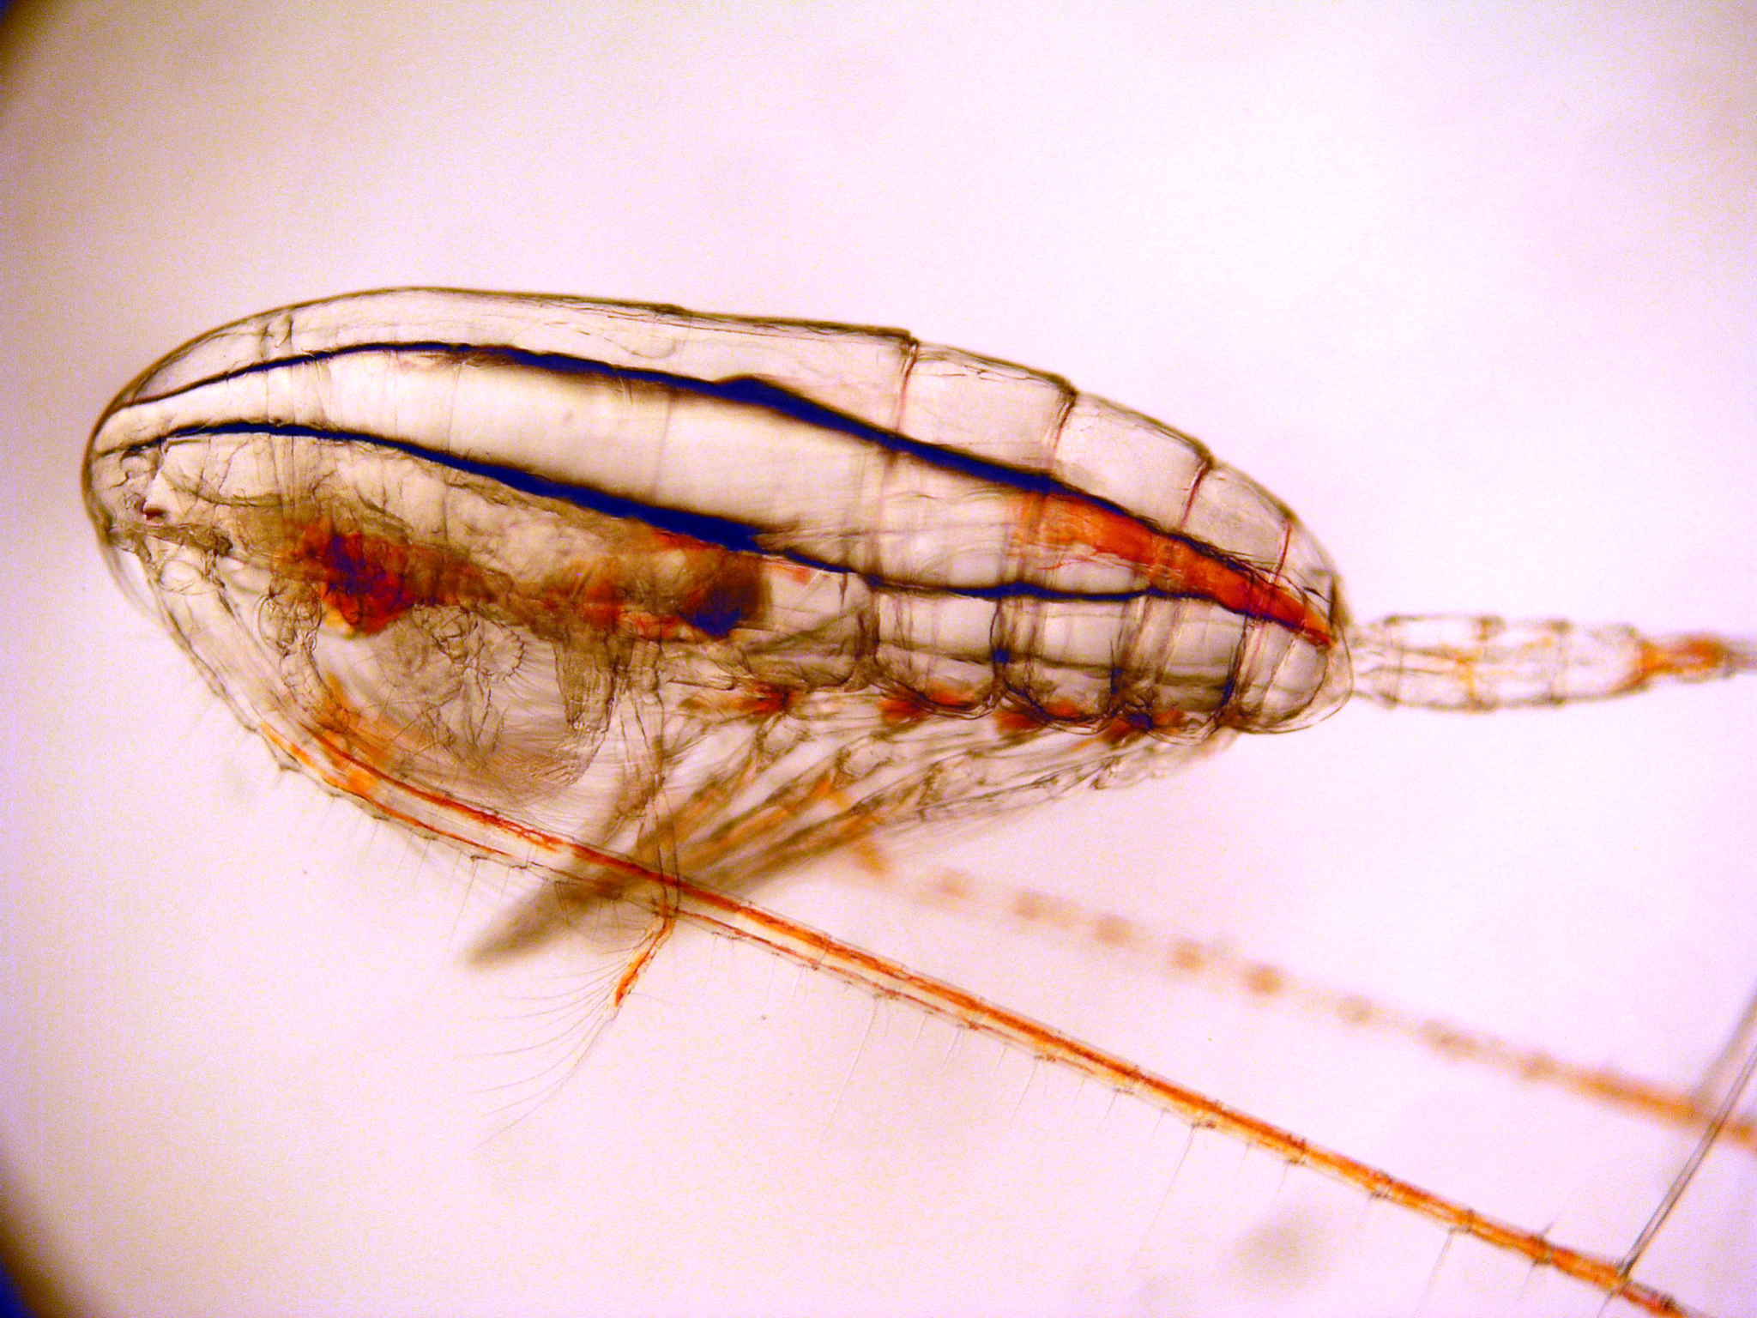
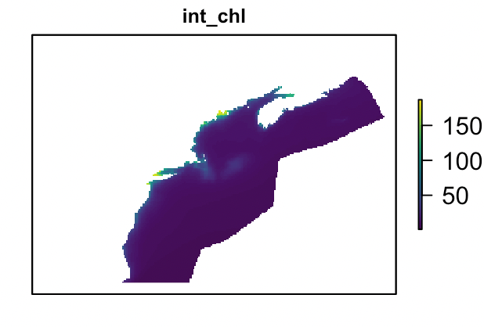
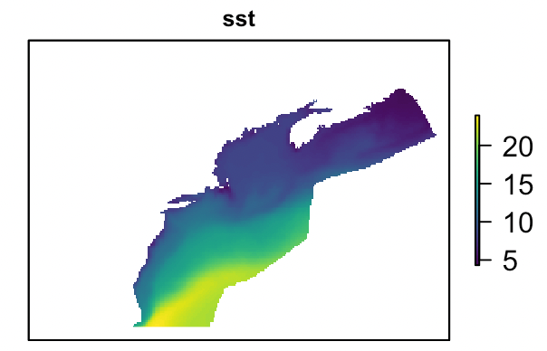
Environmental data
Species abundance data
Habitat map
+
=
calanus-finmarchicus.jpg

Slide 5
Types of Species Distribution Models

Slide 6
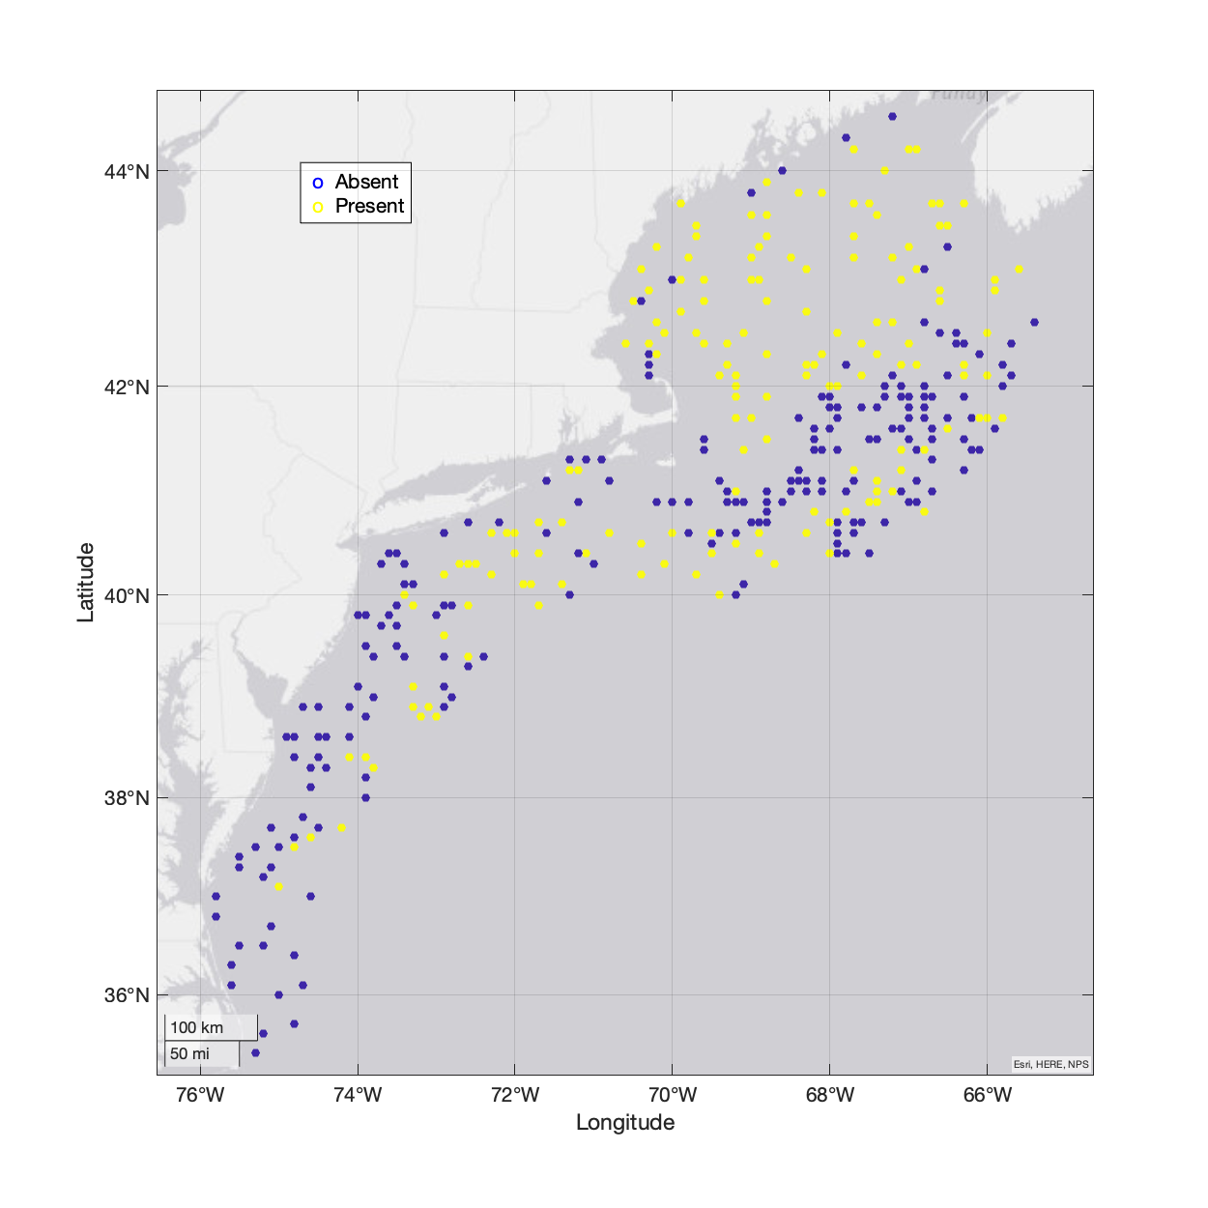
Types of data
Abundance data
Presence/absence data
Presence-only data

Slide 7
Species distribution modeling algorithms
Generalized additive models (GAMs)
Boosted regression trees (BRTs)
Random forest models
Maximum entropy models (MaxEnt)
Neural networks

Slide 8
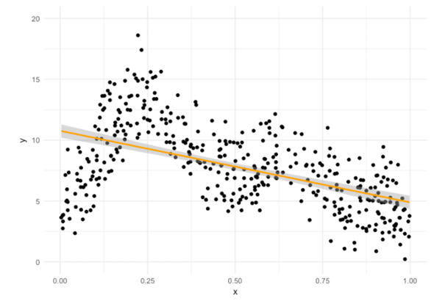
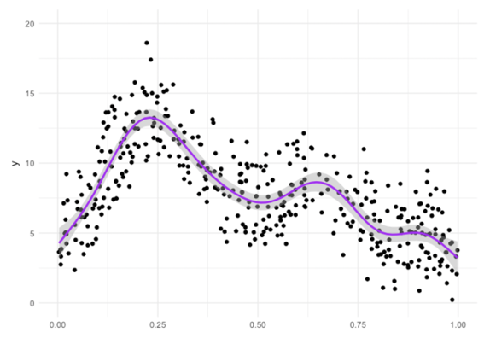
Generalized additive models
SST
SST
Graph source: https://noamross.github.io/gams-in-r-course/chapter1

Slide 9
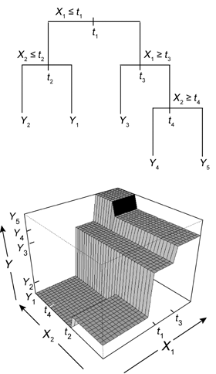
Boosted regression trees
SST
BAT
Source: jane_1390_f1.gif

Slide 10
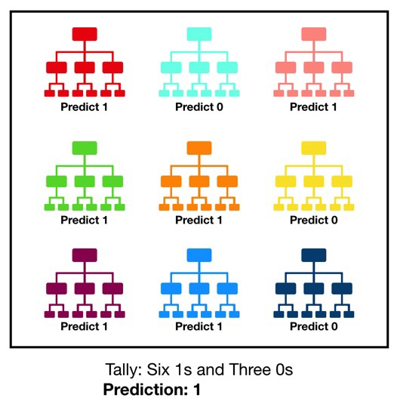
Random forests
Source: 1*VHDtVaDPNepRglIAv72BFg.jpeg

Slide 11
Example Species Distribution Model

Slide 12
Background
Calanus finmarchicus is a key prey resource for critically endangered North Atlantic right whales
Understanding where C. finmarchicus is can help us understand where right whales will be
Aids in conservation

Slide 13
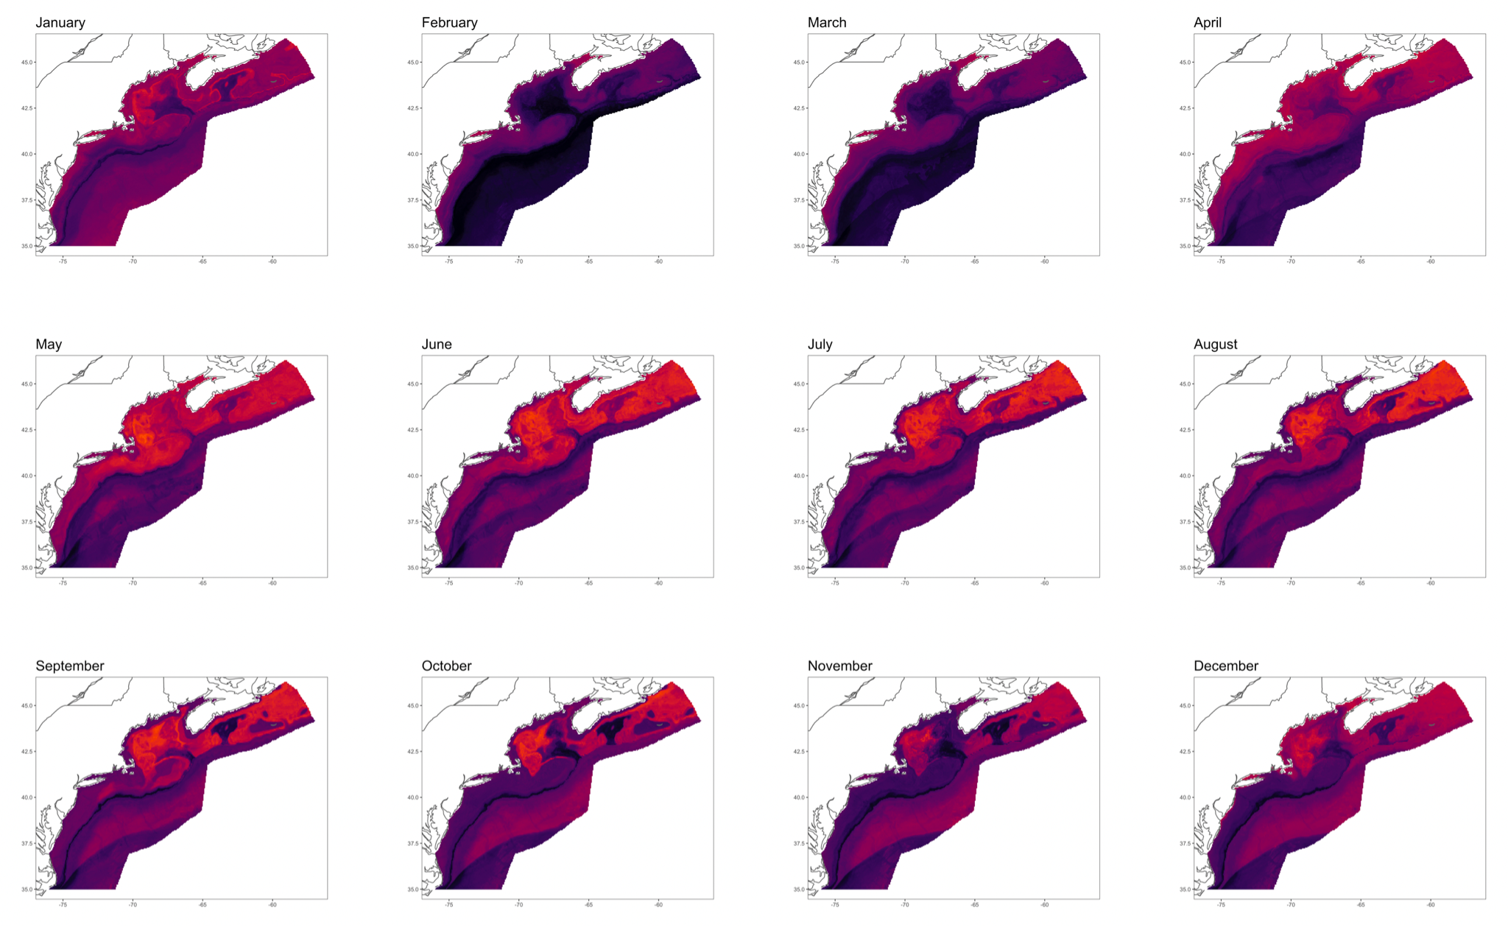
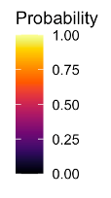

Slide 14
Thank you! Any questions?

